Slide 1
Retail store sales analysis
TEAM Members:
G.PRANAY
K.SATHWIK

Slide 2
Overview
Dataset Link: https://github.com/bushraghaffar19/CODING-SAMURAI-INTERNSHIP-TASK/blob/main/Task%201%20%20Retail%20Store%20Sales%20Analysis/retail%20store%20data.xlsx
Data Cleaning: Data cleaning for the Sales Dataset is essential and involves removing duplicates, fixing spelling errors, handling empty rows, standardizing date formats in the "Order Date" column, and ensuring a uniform monetary format in the "Sales" column. This process ensures data accuracy and integrity, making the dataset suitable for analysis.

Slide 3
Analysis

Slide 4
Analysis:
The retail store sold a total of 7,977 units of products.
The store generated 1 million in revenue.
The average order price is $687.
The store has 1,616 customers.
The store sells 16 different products.
Sales are spread across 16 districts.

Slide 5
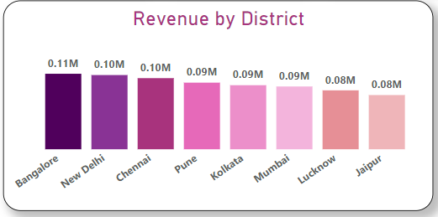
Revenue by district:
Bangalore stands out as the highest revenue-generating district with 0.11 million, followed closely by New Delhi and Chennai, each contributing 0.10 million to the revenue.

Slide 6
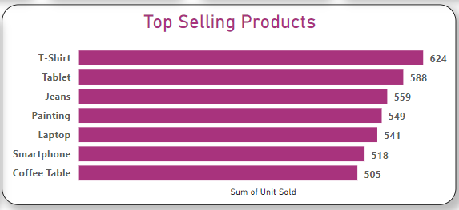
Top Selling products:
T-shirts are the most popular product category, followed by Tablets and Jeans.

Slide 7
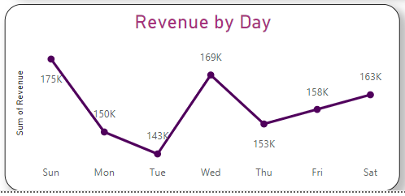
Revenue by day:
Sunday is the day with the highest sales revenue

Slide 8
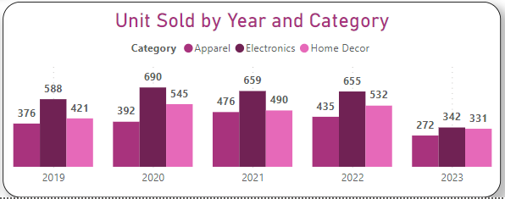
Revenue by district:
Electronics items, in particular, had strong sales each year, with 2020 being the most revenue-generating year.

Slide 9
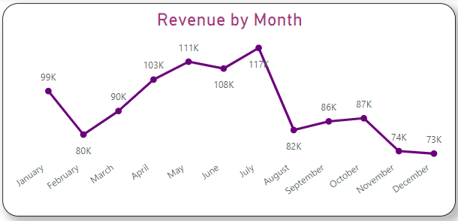
Revenue by district:
July consistently generates the highest revenue each month.

Slide 10
Strategies to improve sales:
District-Specific Marketing: Allocate marketing budgets based on district performance. Invest more in advertising and promotions in districts like Bangalore, New Delhi, and Chennai, which are top revenue generators. Tailor your marketing messages to address the preferences and demographics of each district.
Product Focus: Given that T-shirts are the best-selling product category, consider expanding the range of T-shirt styles, designs, and sizes. Run promotions and bundles centered around T-shirts to encourage upselling and cross-selling.
Monthly Marketing Focus: Given that July consistently generates the highest revenue each month, allocate more marketing resources to July promotions and events. Create a marketing calendar that builds anticipation for July sales.
Sunday Specials: Since Sundays bring in the highest revenue, consider introducing special promotions or events on Sundays to maximize sales. This could include exclusive discounts, product launches, or themed sales events.
Yearly Sales Planning: Recognize the popularity of electronics items, especially in 2020. Plan for similar sales events in the future and stock up on electronics inventory during high-demand periods. Consider offering extended warranties or after-sales support for electronic products.

